Slide 1
Search Trees
Lecture # 17

Slide 2
Search Trees
The tree structure can be used for searching.
Each node contains a search key as part of its data or payload.
Nodes are organized based on the relationship between the keys.
Search trees can be used to implement various types of containers.
Most common use is with the Map ADT.

Slide 3
Binary Search Tree (BST)
A binary tree in which each node contains a search key and the tree is structured such that for each interior node V:
All keys less than the key in node V are stored in the left subtree of V.
All keys greater than the key in node V are stored in the right subtree of V.

Slide 4
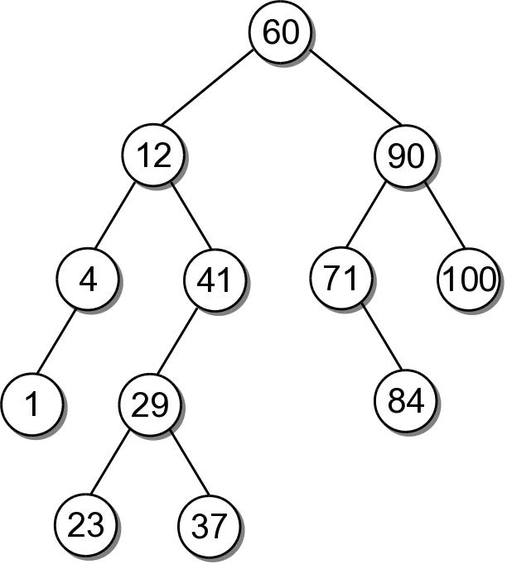
BST Example
Consider the example tree

Slide 5
BST – ADT
bst.py
# We use an unique name to distinguish this version
# from others in the chapter.
class BST :
def __init__( self ):
self._root = None
self._size = 0
def __len__( self ):
return self._size
def __iter__( self ):
return _BSTreeIterator( self._root )
# ...
# Storage class for the binary search tree nodes.
class _BSTNode :
def __init__( self, key, data ):
self.key = key
self.data = data
self.left = None
self.right = None

Slide 6
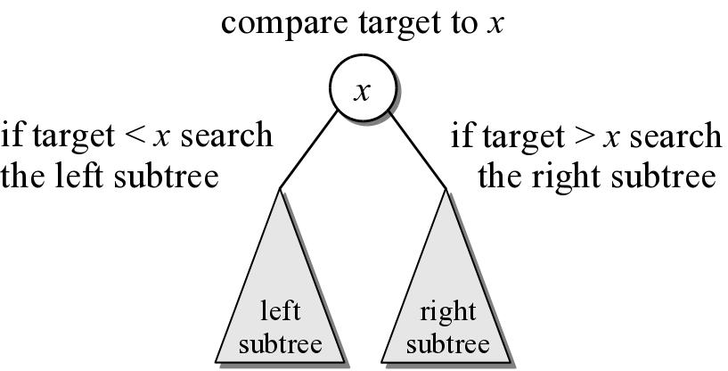
BST – Searching
A search begins at the root node.
The target is compared to the key at each node.
The path depends on the relationship between the target and the key in the node.

Slide 7
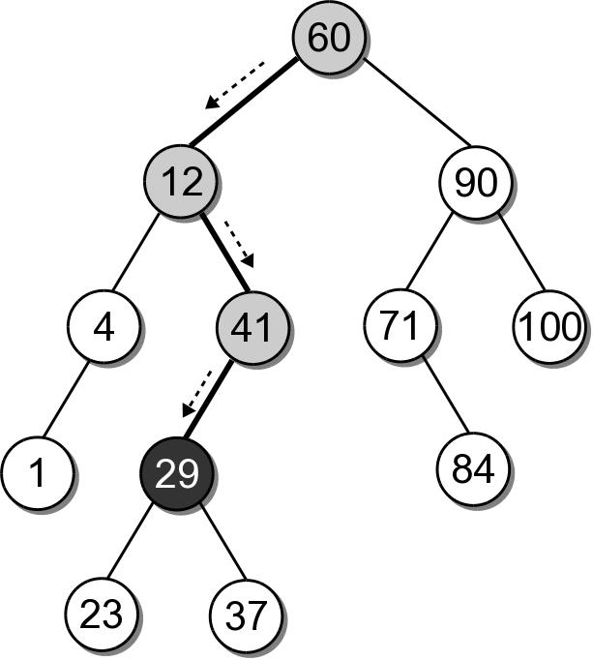
BST – Search Example
Suppose we want to search for 29 in our BST.

Slide 8
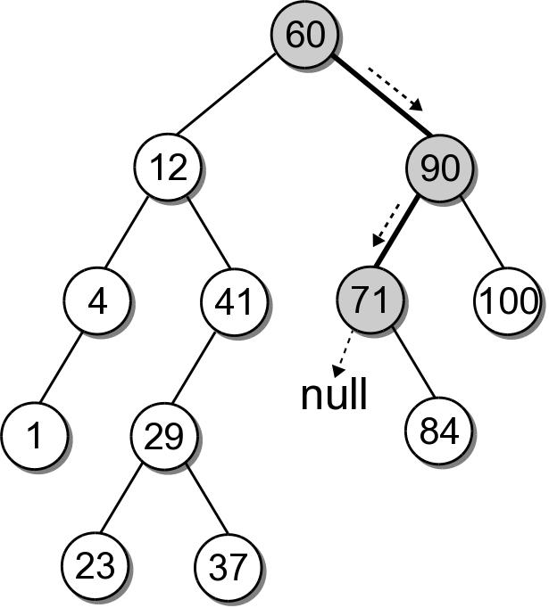
BST – Search Example
What if the key is not in the tree? Search for key 68 in our BST.

Slide 9
BST – Search Implementation
bst.py
class BST :
# ...
def __contains__( self, key ):
return self._bstSearch( self._root, key ) is not None
def valueOf( self, key ):
node = self._bstSearch( self._root, key )
assert node is not None, "Invalid map key."
return node.value
def _bstSearch( self, subtree, target ):
if subtree is None :
return None
elif target < subtree.key :
return self._bstSearch( subtree.left )
elif target > subtree.key :
return self._bstSearch( subtree.right )
else :
return subtree

Slide 10
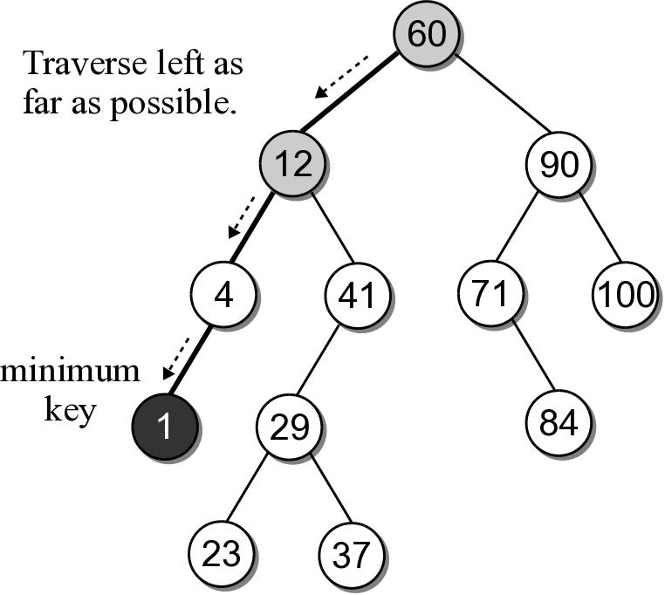
BST – Min or Max Key
Finding the minimum or maximum key within a BST is similar to the general search.
Where might the smallest key be located?
Where might the largest key be located?

Slide 11
BST – Min or Max Key
The helper method below finds the node containing the minimum key.
class BST :
# ...
def _bstMinumum( self, subtree ):
if subtree is None :
return None
elif subtree.left is None :
return subtree
else :
return self._bstMinimum( subtree.left )

Slide 12
BST – Insertions
When a BST is constructed, the keys are added one at a time. As keys are inserted
A new node is created for each key.
The node is linked into its proper position within the tree.
The search tree property must be maintained.

Slide 13
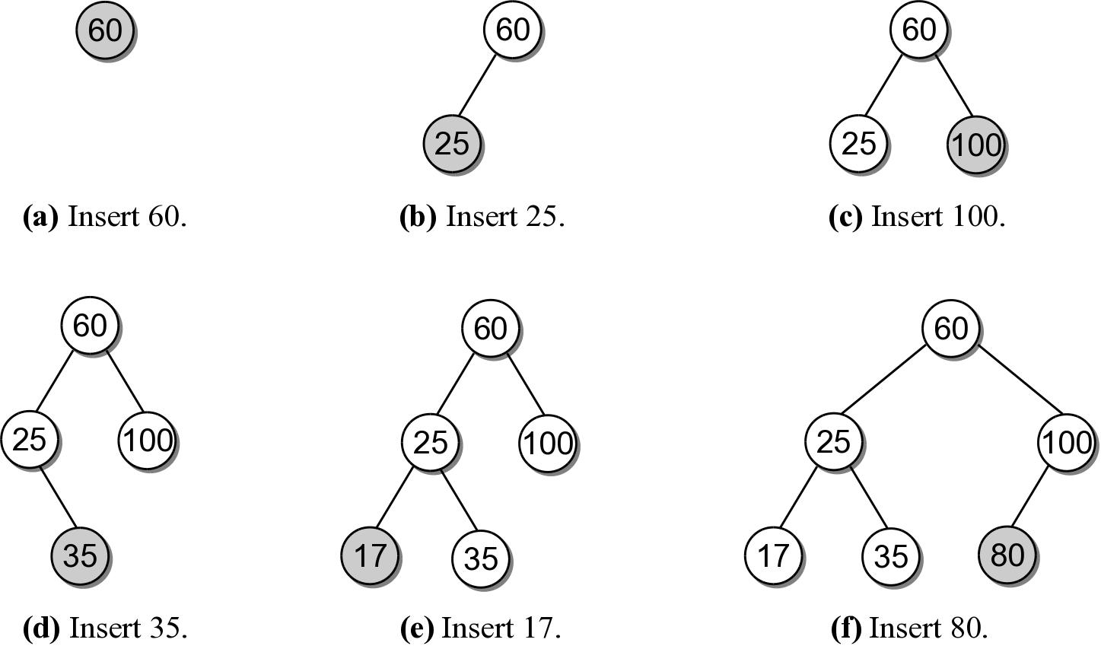
Building a BST
Suppose we want to build a BST from the key list
60 25 100 35 17 80

Slide 14
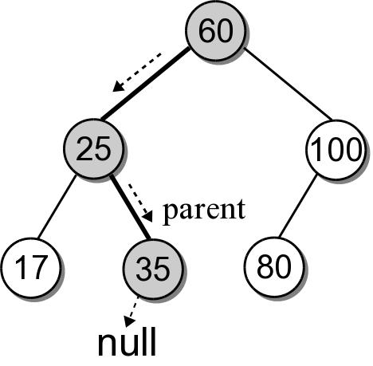
BST – Insertion
Building a BST by hand is easy. How do we insert an entry in program code?
What happens if we use the search method from earlier to search for key 30?

Slide 15
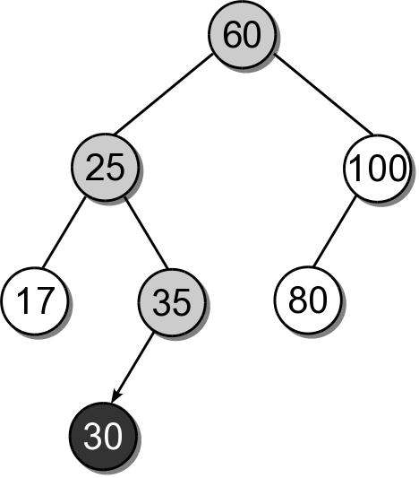
BST – Insertion
We can insert the new node where the search fell off the tree.

Slide 16
BST – Insert Implementation
bst.py
class BST :
# ...
def add( self, key, value ):
node = self._bstSearch( key )
if node is not None :
node.value = value
return False
else :
self._root = self._bstInsert( self._root, key, value )
self._size += 1
return True
def _bstInsert( self, subtree, key, value ):
if subtree is None :
subtree = _BSTMapNode( key, value )
elif key < subtree.key :
subtree.left = self._bstInsert(subtree.left, key, value)
elif key > subtree.key :
subtree.right = self._bstInsert(subtree.right, key, value)
return subtree

Slide 17
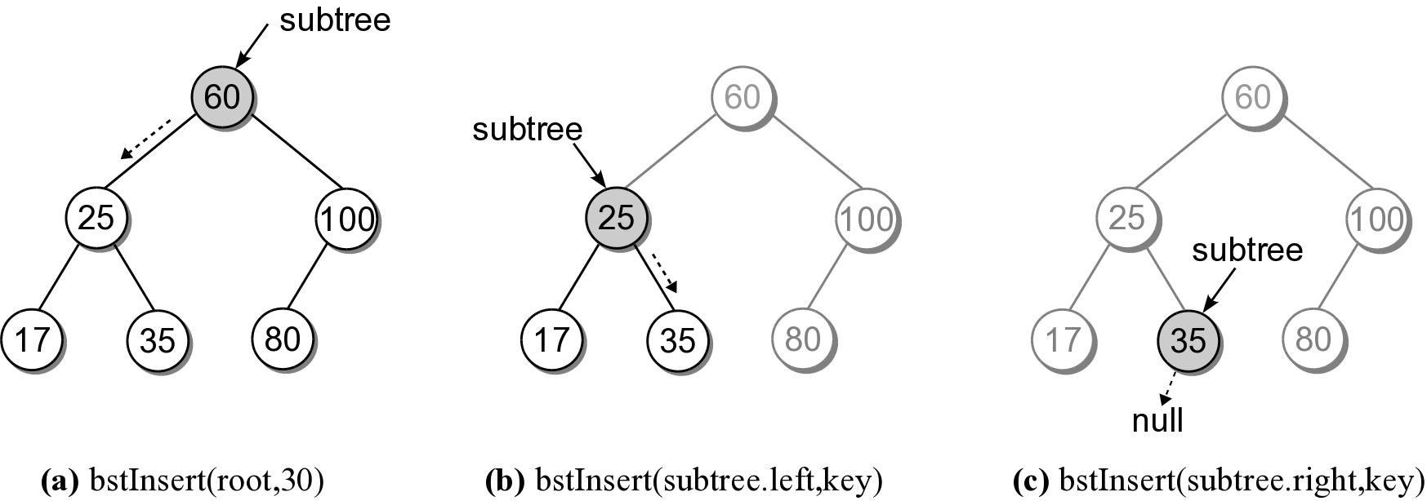
BST – Insert Steps
Add 30 to our sample BST.

Slide 18
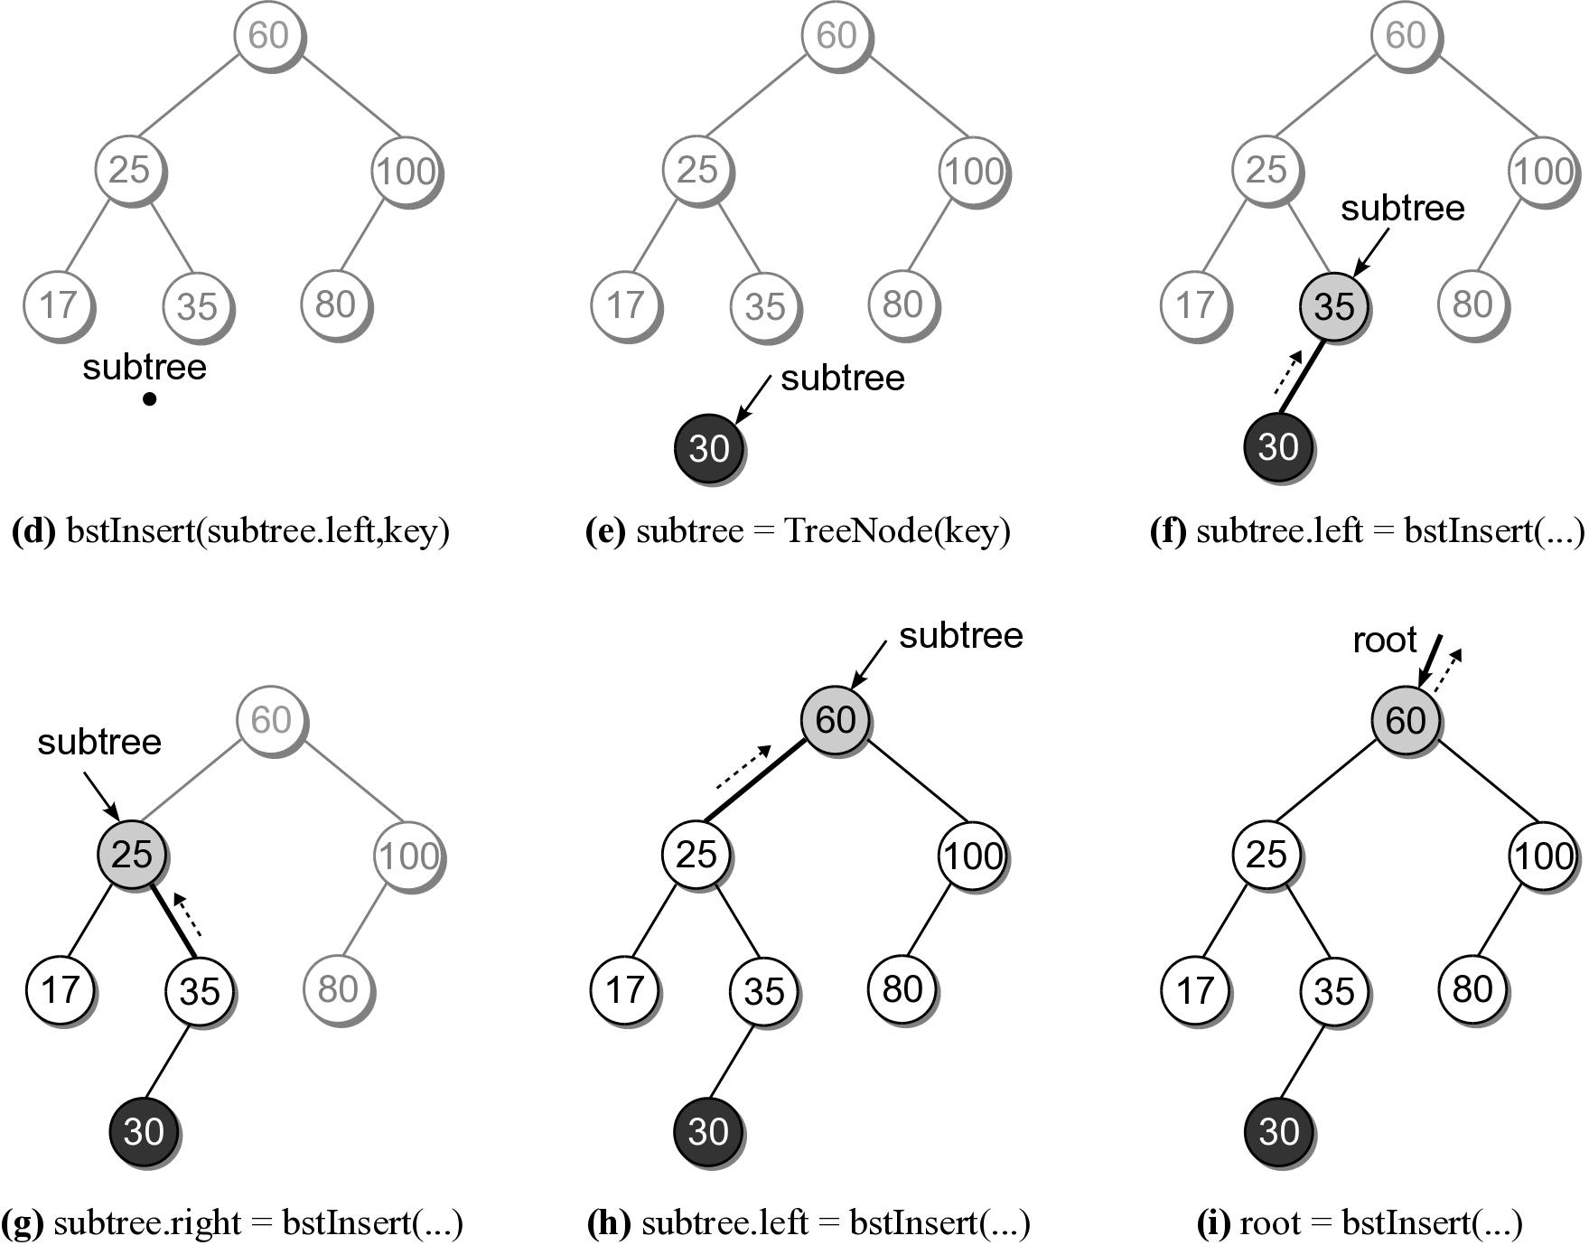
BST – Insert Steps

Slide 19
BST – Deletions
Deleting a node from a BST is a bit more complicated.
Locate the node containing the node.
Delete the node.
When a node is removed, the remaining nodes must preserve the search tree property.

Slide 20
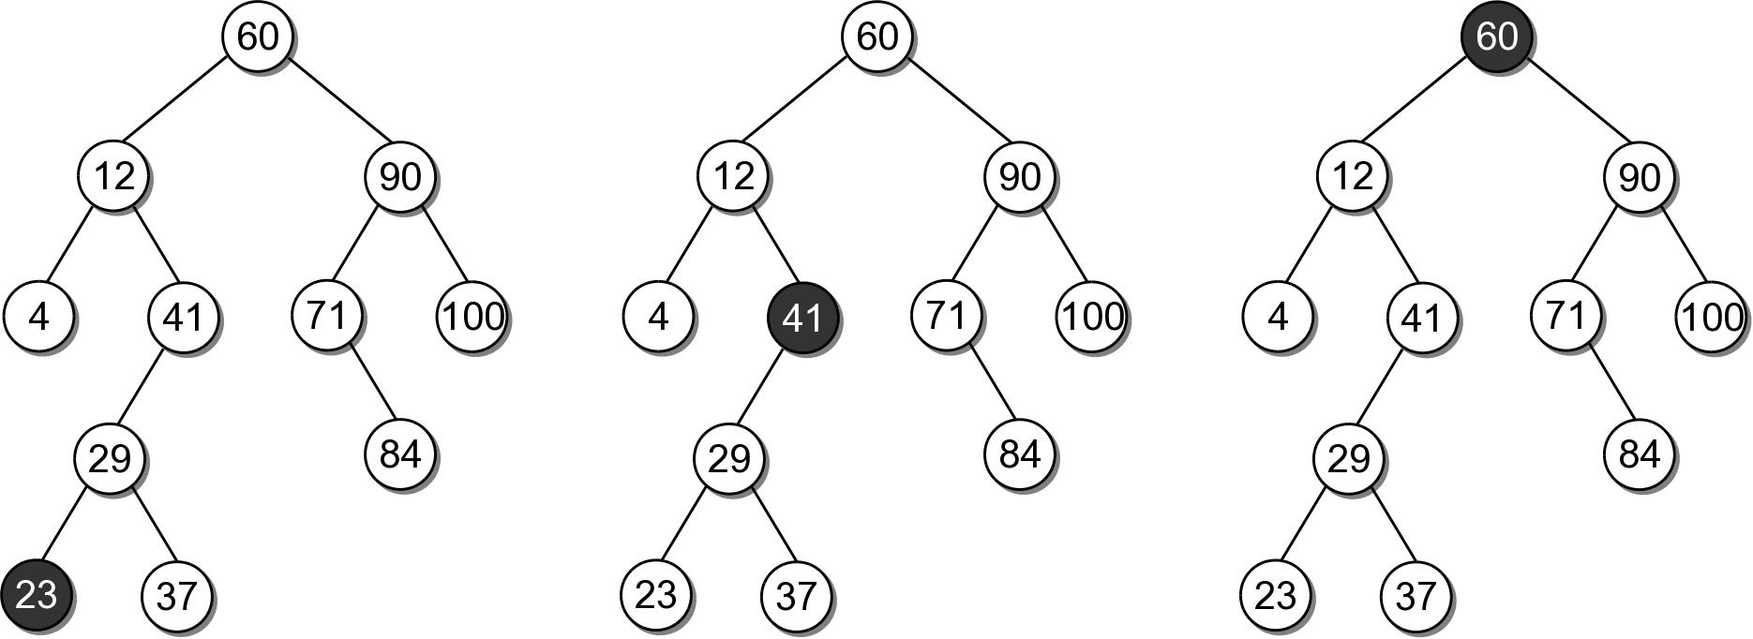
BST – Deletions
There are three cases to consider:
the node is a leaf.
the node has a single child
the node has two children.

Slide 21
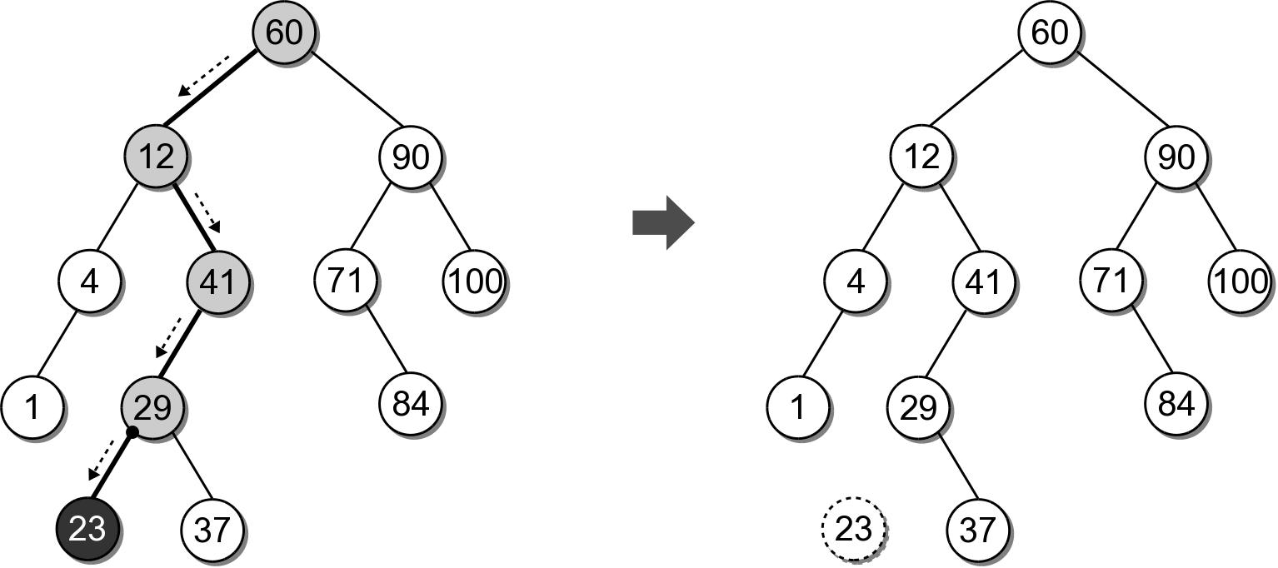
BST – Delete Leaf Node
Removing a leaf node is the easiest case.
Suppose we want to remove 23.

Slide 22
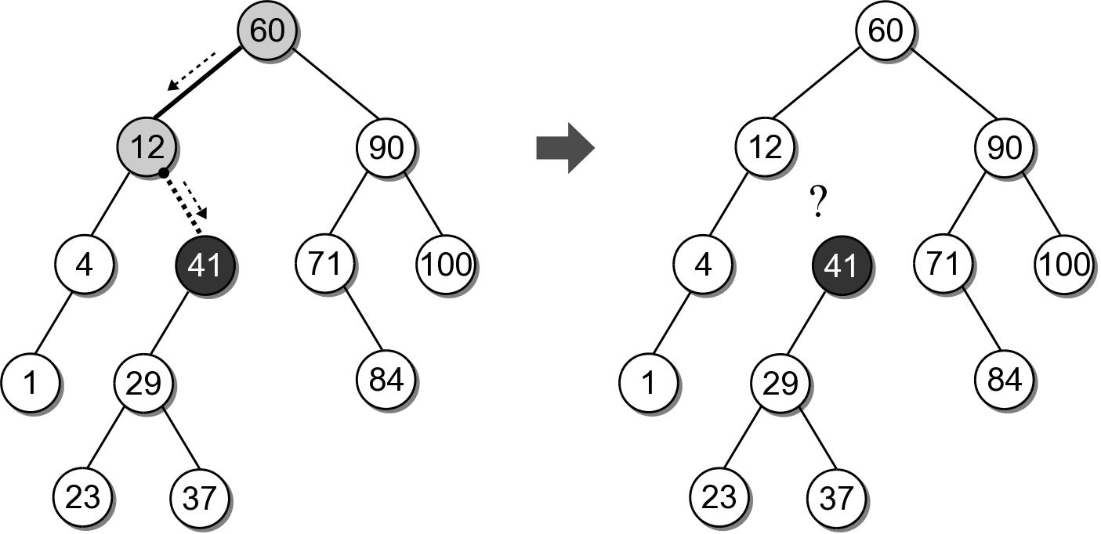
BST – Delete Interior Node
Removing an interior node with one child.
Suppose we want to remove 41.
We can not simply unlink the node.

Slide 23
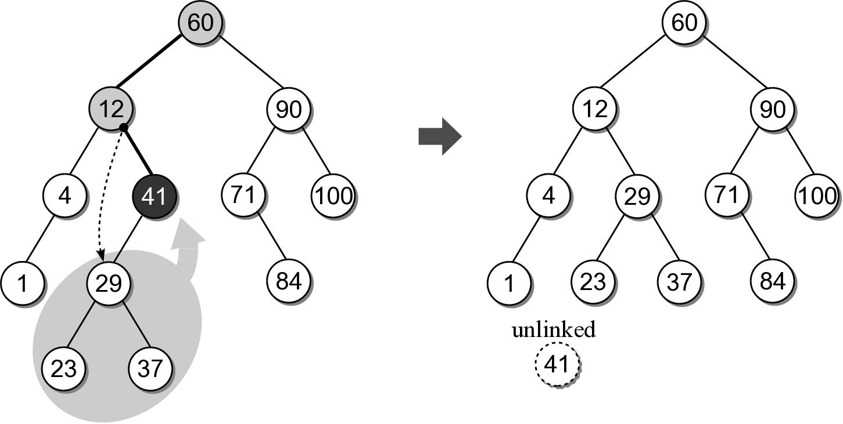
BST – Delete Interior Node
After locating the node to be removed, it's child must be linked to it's parent.

Slide 24
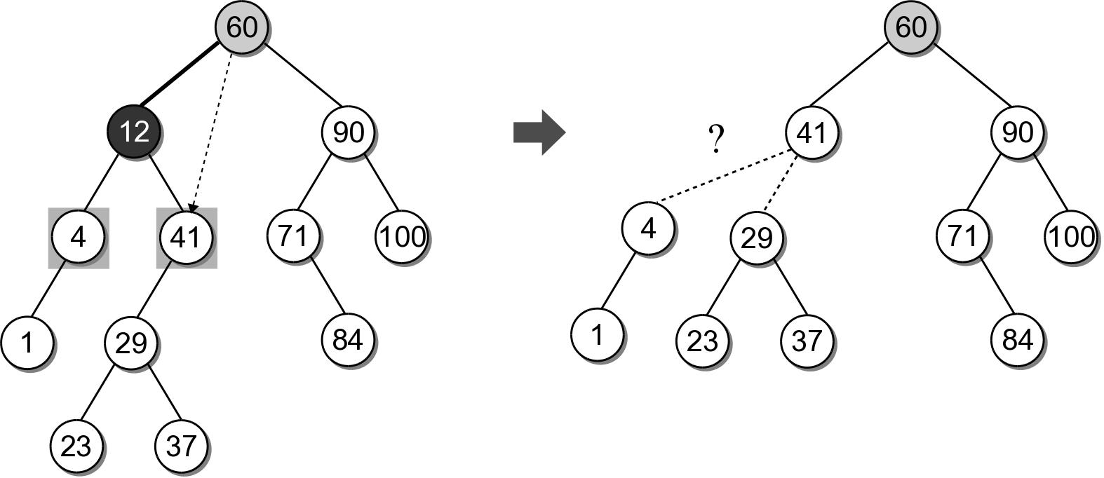
BST – Delete Interior Node
The most difficult case is deleting a node with two children.
Suppose we want to delete node 12.
Which child should be linked to the parent?

Slide 25
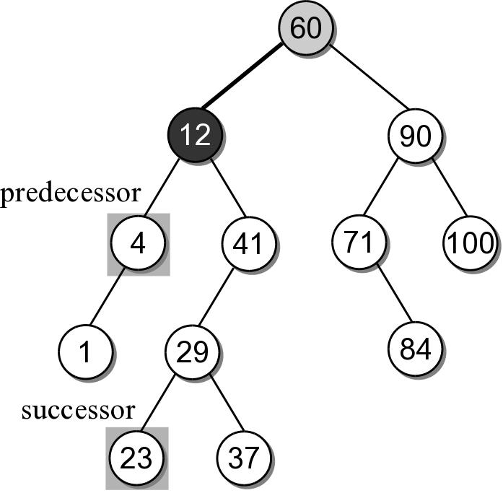
BST – Delete Interior Node
Based on the search tree property, each node has a logical predecessor and successor.
For node 12, those are 4 and 23.

Slide 26
BST – Delete Interior Node
We can replace to be deleted with either its logical successor or predecessor.
Both will either be a leaf or an interior node with one child.
We already know how to remove those nodes.

Slide 27
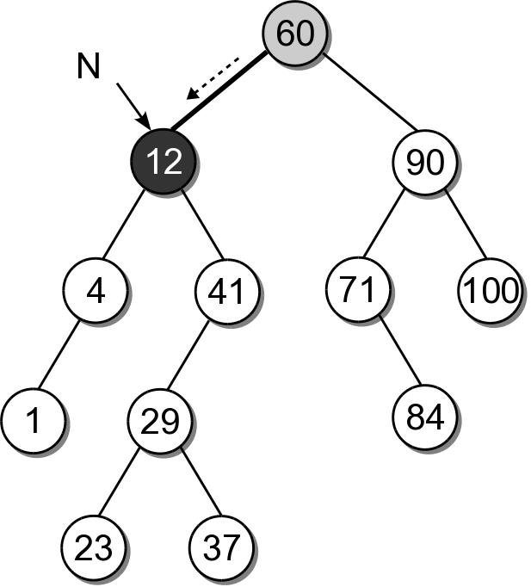
BST – Delete Interior Node
Removing an interior node with two children requires 4 steps:
(1) Find the node to be deleted, N.

Slide 28
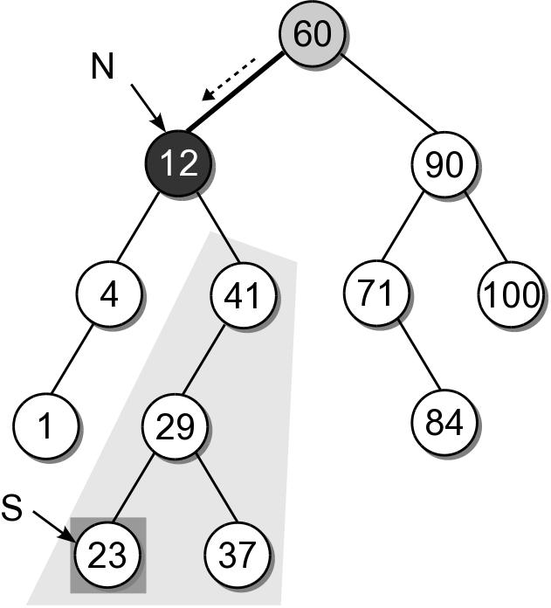
BST – Delete Interior Node
(2) Find the successor, S, of node N.

Slide 29
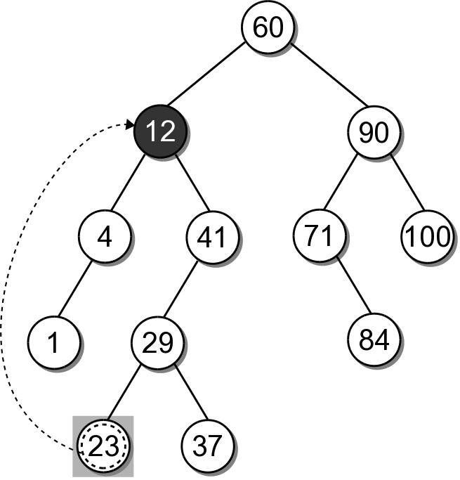
BST – Delete Interior Node
(3) Copy the payload from node S to node N.

Slide 30
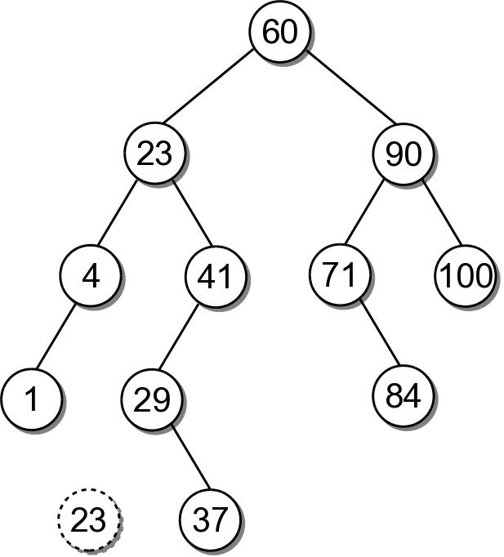
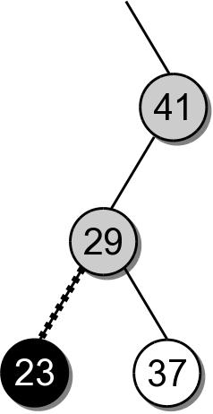
BST – Delete Interior Node
(4) Remove node S from the tree.

Slide 31
BST – Delete Interior Node
Removing an interior node with two children requires 4 steps:
Find the node to be deleted, N.
Find the logical successor, S, of node N.
Copy the payload from node S to node N.
Remove node S from the tree.

Slide 32
BST – Delete Implementation
bst.py
class BST :
# ...
def remove( self, key ):
assert key in self, "Invalid key."
self._root = self._bstRemove( self._root, key )
self._size -= 1

Slide 33
BST – Delete Implementation
bst.py
class BST :
# ...
def _bstRemove( self, subtree, target ):
if subtree is None : # not found
return subtree
elif target < subtree.key : # search for the left tree
subtree.left = self._bstRemove( subtree.left, target )
return subtree
elif target > subtree.key : # search for the right tree
subtree.right = self._bstRemove( subtree.right, target )
return subtree
else : # target == subtree.key, delete the node
......

Slide 34
BST – Delete Implementation
bst.py
class BST :
# ...
def _bstRemove( self, subtree, target ):
......
else :
if subtree.left is None and subtree.right is None :
return None # leaf node
elif subtree.left is None or subtree.right is None :
# has one child only
if subtree.left is not None :
return subtree.left
else :
return subtree.right
else : # has both children
successor = self._bstMinimum( subtree.right )
subtree.key = successor.key
subtree.value = successor.value
subtree.right = self._bstRemove( subtree.right,
successor.key )
return subtree

Slide 35
BST – Efficiency
Operation | Worst Case
_bstSearch( root, k ) | O(n)
_bstMinimum( root ) | O(n)
_bstInsert( root, k ) | O(n)
_bstRemove( root, k ) | O(n)
traversal | O(n)

Slide 36
Exercises
The remove() method uses a bst_find_min(subtree) method to search and return the node with minimum key in a tree rooted at subtree. Implement this method.
Write a method bst_sort_reverse() to sort a binary search tree rooted at subtree in reverse order.
Test your methods by running the program testbst.py on the course website.

Slide 37
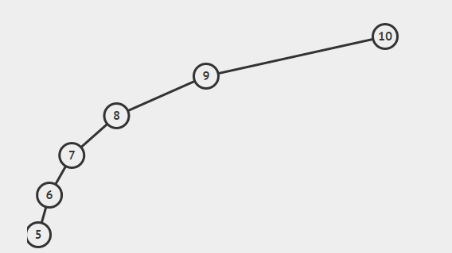
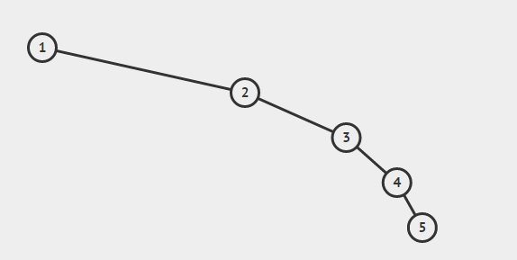
How bad!?!?
Balance – the height of left and right subtree approximately equal
Our standard binary trees can be bad!
What if we made a search tree from an ordered list?

Slide 38
AVL Tree Background
Developed by G.M. Adelson-Velskii and E.M. Landis in 1962
Goal: try to keep the tree balanced during insertion and removal.
Ensures height never exceeds 1.44 log n
Worst case of tree height O(log n)
An AVL tree is a binary search tree that the height of two children differ by no more than one.

Slide 39
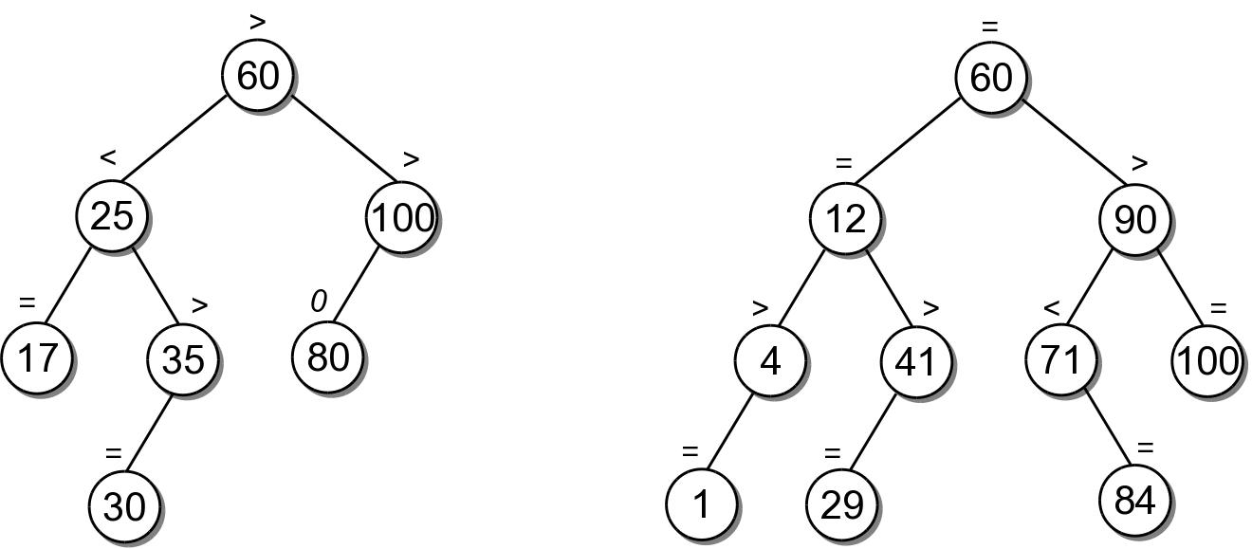
These are AVL trees, ‘=‘ denotes children are of equal height, ‘<‘ or ‘>’ differ by one.
=

Slide 40
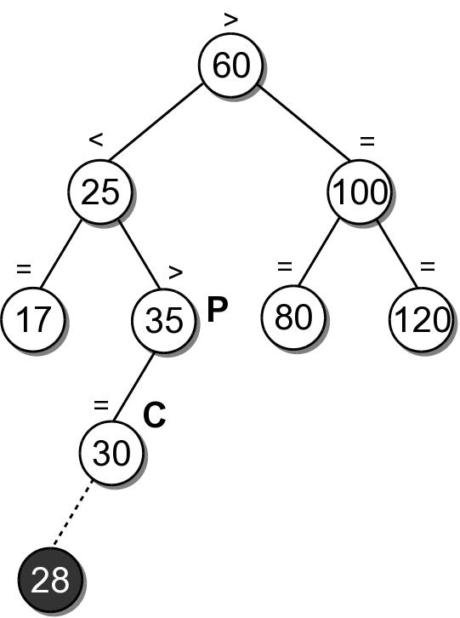
The tree on the right is not an AVL tree, after the node with 28 is inserted. The balance signs along the branch where 28 is inserted have to be revised. And the tree has to be re-balanced if to maintain it as an AVL tree.

Slide 41
Balance Factor
So what states of balance exist?
Left-high ‘>’
Equal-high ‘=‘
Right-high ‘<‘
=

Slide 42

How do we maintain balance?
Well that is the million dollar question!
We will use rotations!
All rotations happen at a fixed point
This fixed point is the pivot node
Not really the instance of the node, but the location of the node!

Slide 43
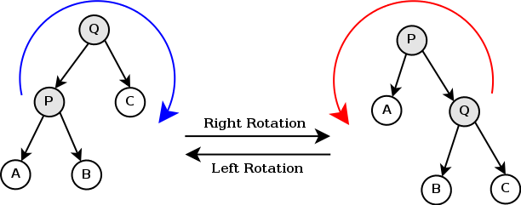
Rotations
Left Rotation
Pivot P
P becomes the parent of B
Q becomes the parent of P
Right Rotation
Pivot Q
Q becomes the parent of B
P becomes the parent of Q

Slide 44


Rotations

Slide 45
Insertion
Now we have our weapon (rotations) and we will use it
Step 1. Find a place to add the element as a leaf node
Same as BST
Step 2. Rebalance
Four Cases to consider

Slide 46
Case 1.
Add to the left side of a subtree that is already left-high
Insert 28.
Walk down to find a place to insert 28.
Walk back up the path and found a node with left-high and we added to the left! Now very left-high! We need to fix this!
Fix?

Slide 47
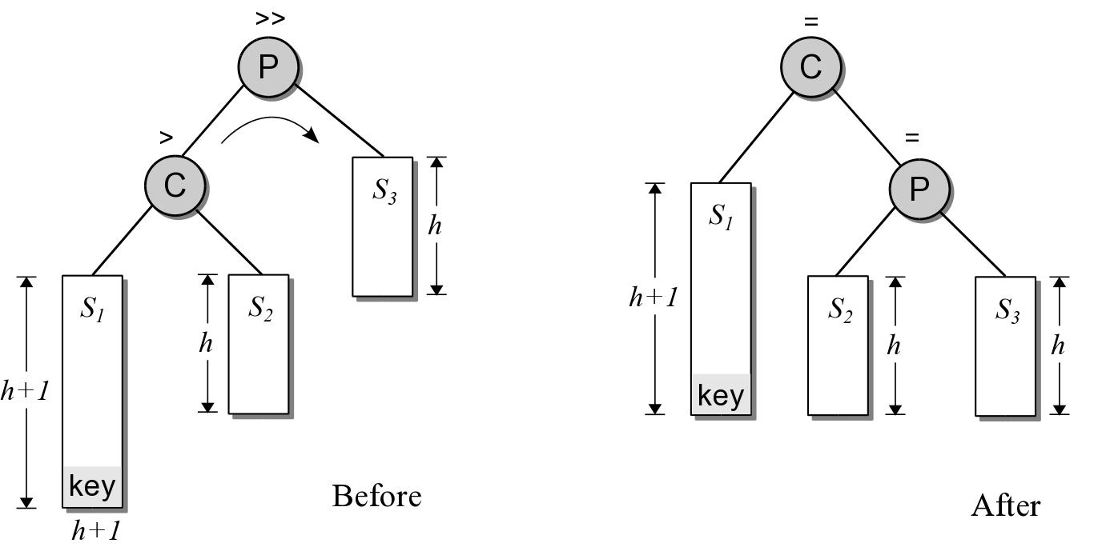
Case 1
How do we fix the balance?
At the node with left-high (P) on the return path,….
What do we know about the subtree P?
We know the left side subtree height is now 2 nodes higher than the height of the right subtree
We know if we could rotate one node for the left into the right the subtrees will be equal
Therefore, rotate right!

Slide 48
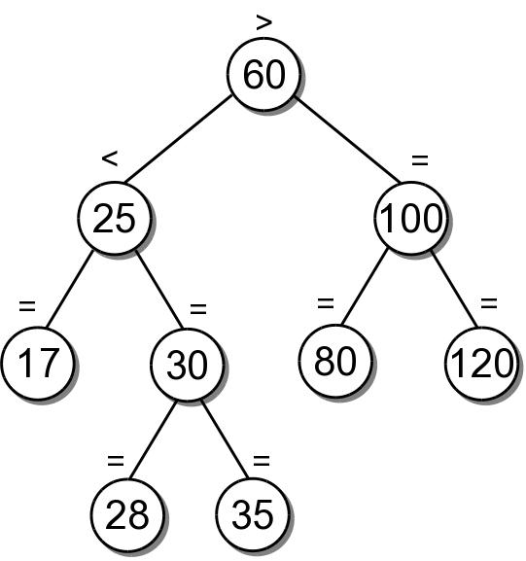
Easy Example (Case 1)

Slide 49
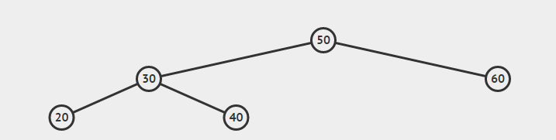
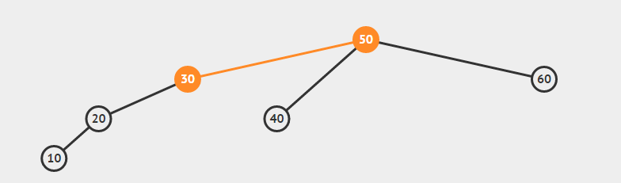
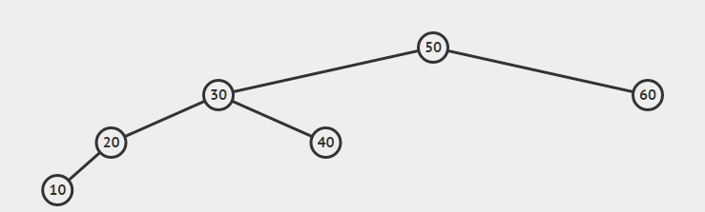
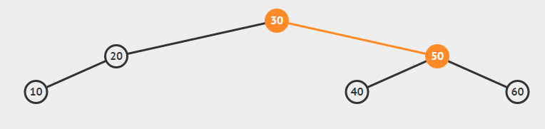
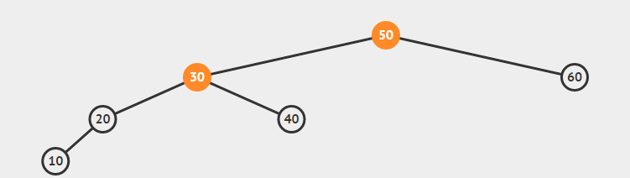
More Complex Example (Case 1)
50 – Left-heavy

Slide 50
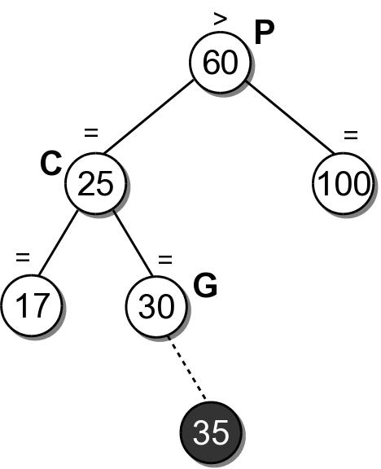
Case 2
Add node as a right or left leaf node of a path where you are right of your grandparent, C, (equal-high) and left of your great grandparent, P, (left-high).
Insert 35.
Walk down to find a place to insert 35.
Walk back up the path to 30, make G right-high ‘<‘
Walk back up the path to 25, make C right-high ‘<‘
Walk back up the path to 60, Oh no! Was already left-high and now left is even more taller! Fix this!
Fix?

Slide 51
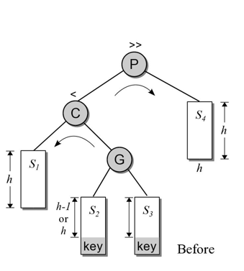
Case 2
How do we fix this imbalance?
At node with left-high (P)
Would a simple rotation help?
Left rotation around P – would make the left branch of P more taller (more ‘left-high’)!
A simple right rotation around P – would make C the new root, P the right child of C, G the left child of P, s1 the left child of C. The tree is not balanced as the right-height(C)= height(P)+1 = height(G)+h+1 >> left-height(C) == h
What if we do a left rotation on the left child of P (node C) first, followed by a right rotation of P?
Result
1. Left rotation on P.left (C in this case)
2. Right rotation on P
2
1

Slide 52
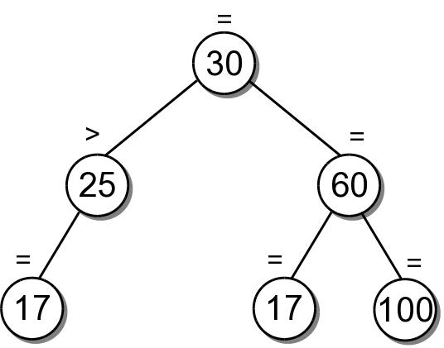
Example (Case 2)
35

Slide 53
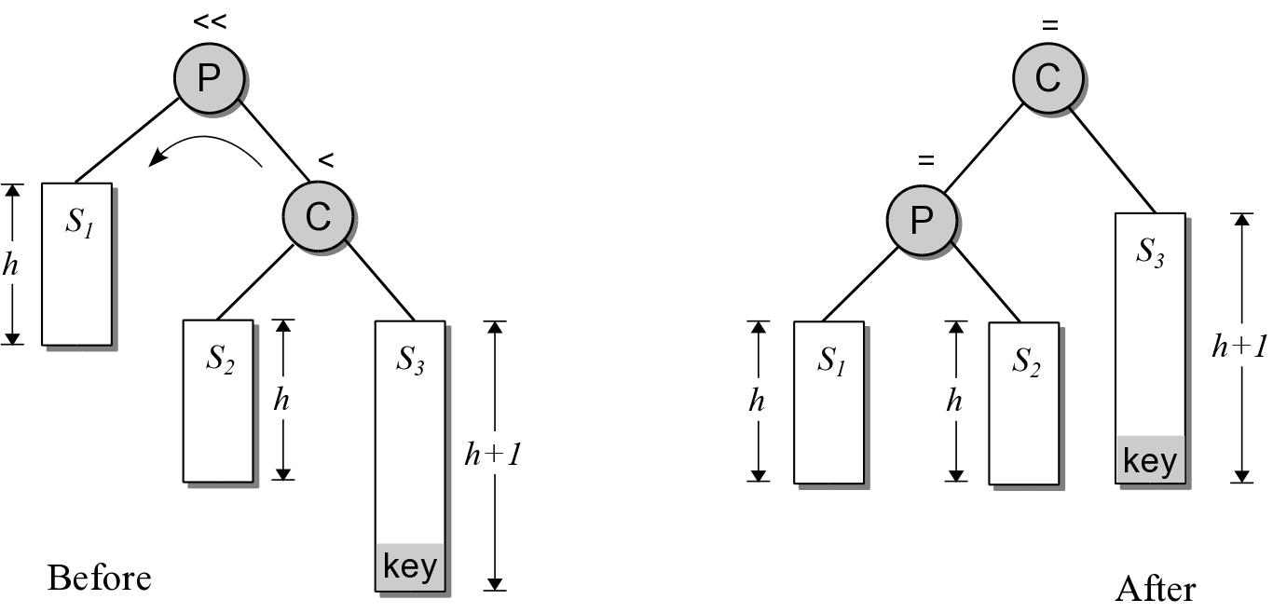
Case 3
Mirror image of Case 1
P is right-high
New key is inserted in right subtree of C
Shown below is ‘before’ and ‘after’ balancing, but after inseration!

Slide 54
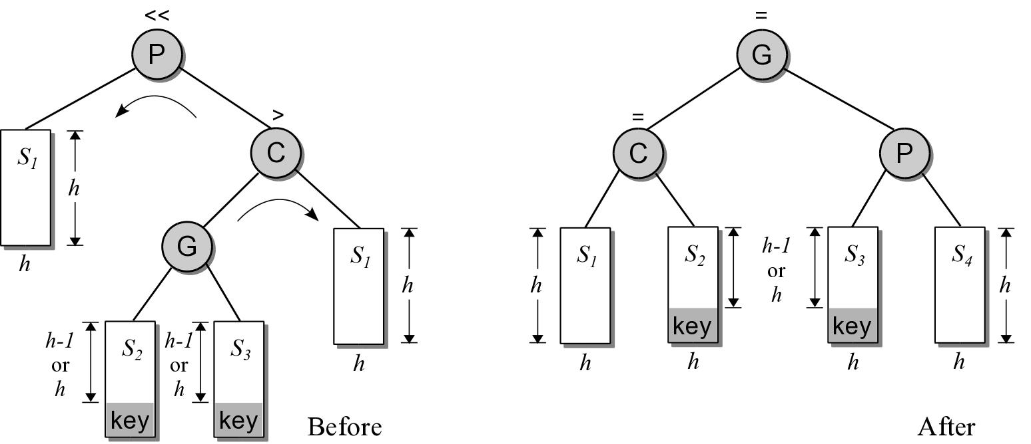
Case 4
Mirror image of Case 2
P is right-high
G is the left child of C instead of the right
Right child of C is S4
S4

Slide 55
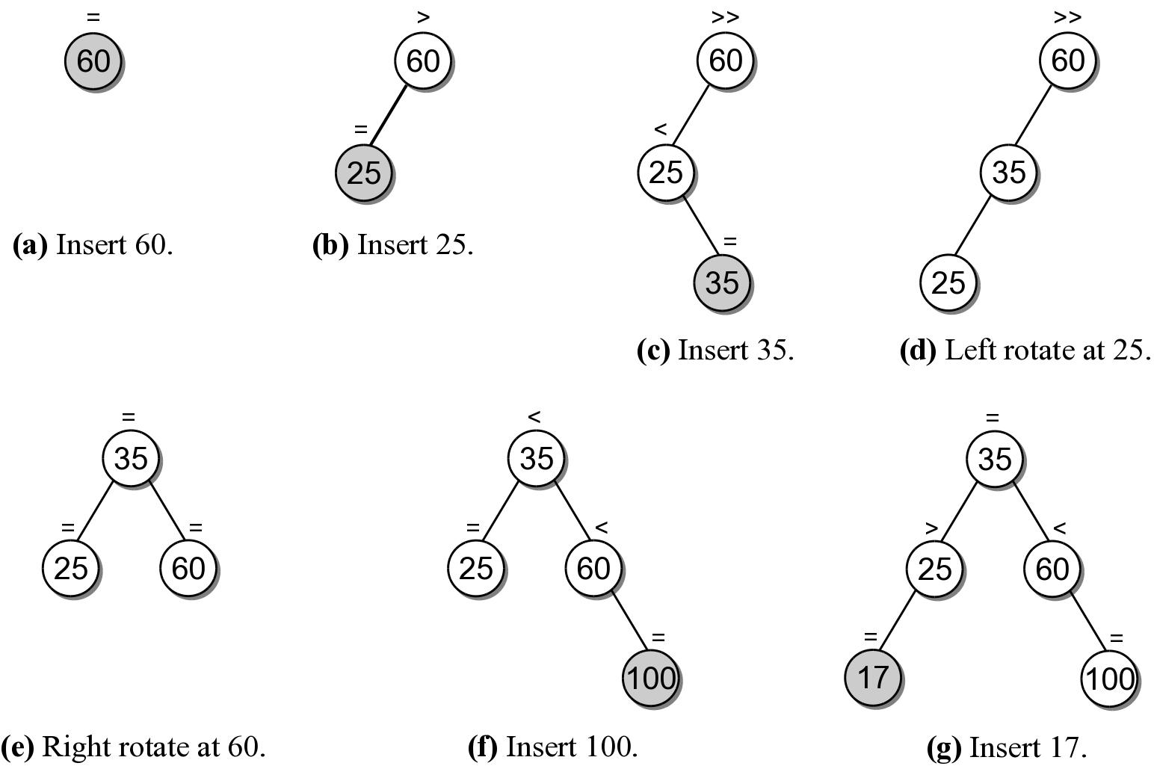
Building AVL Tree [60,25,35,100,17,80]

Slide 56
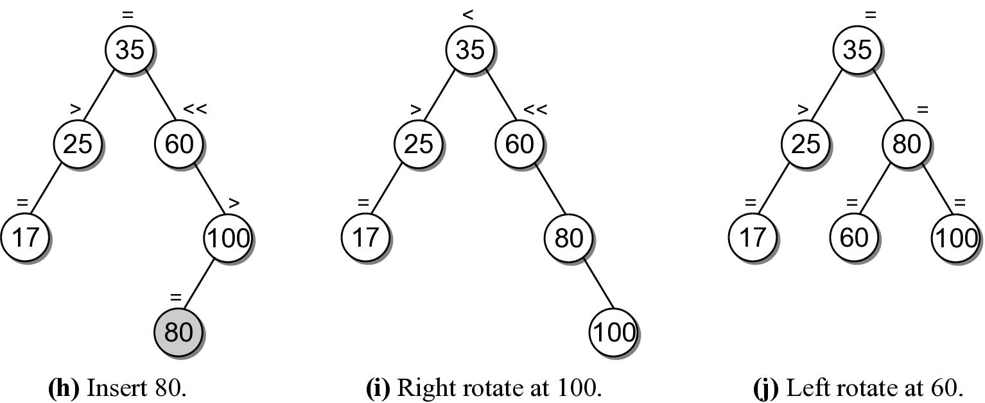
Building AVL Tree [60,25,35,100,17,80]

Slide 57
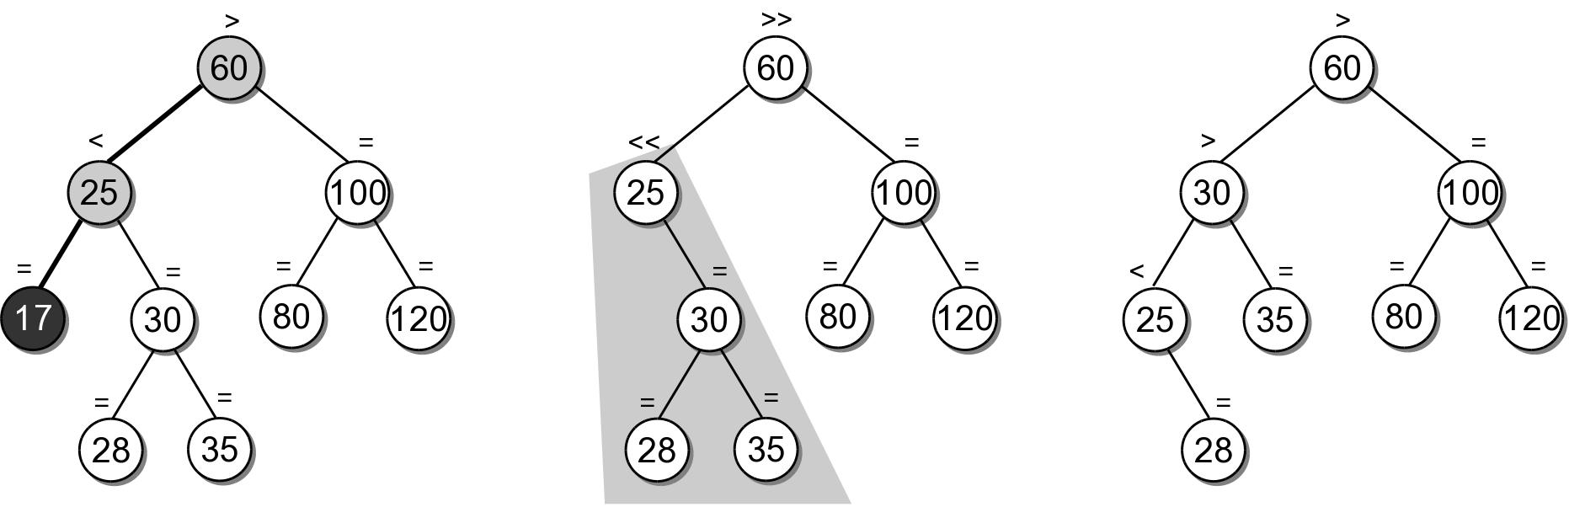
AVL Removal
First remove as we do in BST
Rebalance

Slide 58
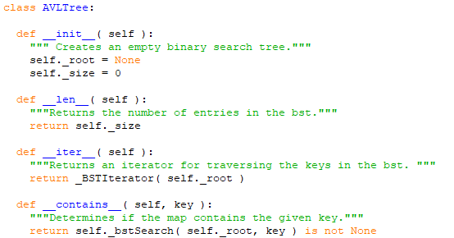
AVL Tree Base
AVL tree is a binary search tree!
The constructor, len (), iter (), contains (), possibly others.

Slide 59
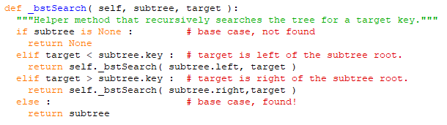
AVL Tree Search
From the contains (self, key) method, the method _bstSearch() is called.

Slide 60
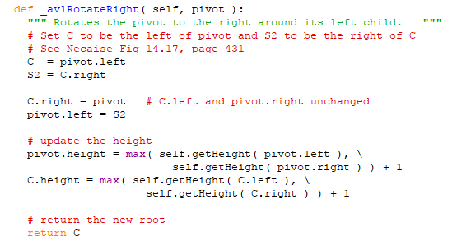
AVL Tree Rotate Right
We discussed the rotations earlier. The full implementation requires adjusting height.

Slide 61
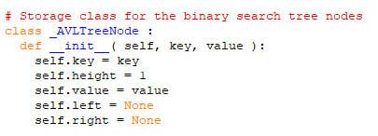
How To Compute Height?
AVL tree node maintains a height attribute, updating it as nodes are added.
# 2. Update the height of the current node subtree.height = max( self.getHeight( subtree.left ), \
self.getHeight( subtree.right ) ) + 1

Slide 62
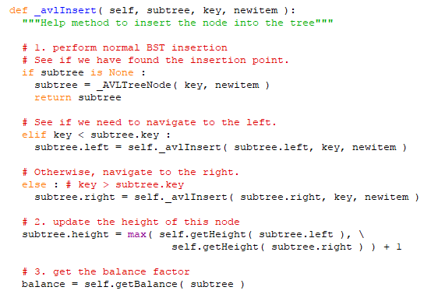
Insert A Node (Part 1)

Slide 63
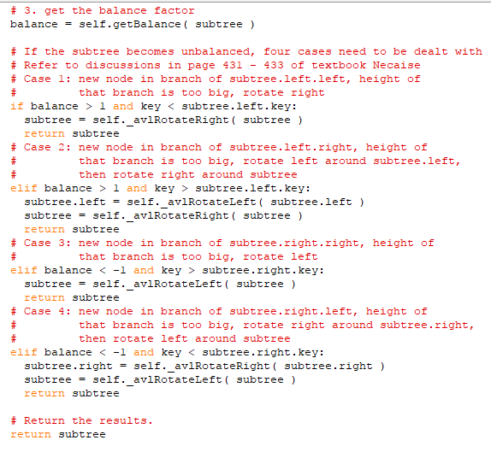
Insert A Node (Part 2)

Slide 64
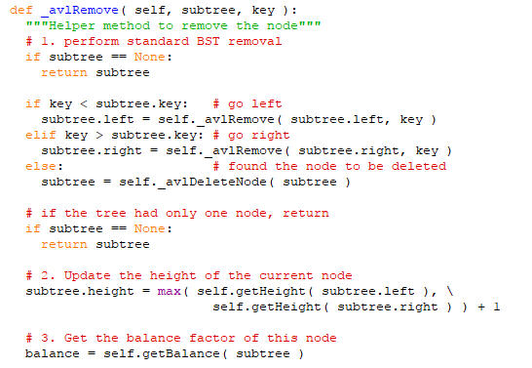
Remove Node (Part1)

Slide 65
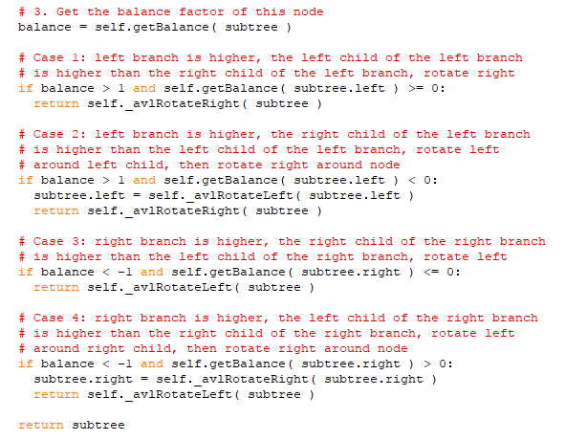
Remove Node (Part 2)

